Slide 1
Outline
Sufficient Condition for Routing Induced Deadlock
Sufficient Condition for Deadlock to Occur with Non-zero Probability
How to Compute the Probability of Pause Events?
Explain the Impact of Extra Flows with Probability Analysis

Slide 2
Sufficient Condition for Routing Induced Deadlock
Deadlock will occur with non-zero probability when the following two conditions are met:
There is a cycle (denoted as C) in the buffer dependency graph of egress queues.
For any edge e(i,j) in the cycle C, tx queue j will pause tx queue i with non-zero probability.

Slide 3
Buffer Dependency Graph of Egress Queues
flow 2
r₂ = B
1
1
rx
tx
tx-1
rx
pause?
pause?
r₁ = B
3
2
flow 1
tx
rx
3
2
rx
tx
flow 3
tx-3
rx
r₃ = B
rx
tx-2
pause?
A lossless network N and a set of flows F.
Buffer dependency graph of tx queues.
If we know the pause probability of any edge in the buffer dependency graph, we can answer whether a deadlock will happen with non-zero probability.

Slide 4
Computation of the Probability of Pause Event
r₁
1
tx-1
pause?
flow 1
rx-1
0
…
r_{i}
i
pause?
rx-i
flow i
tx-i
tx-0
r^{c}
…
pause?
rx-n
r_{n}
n
tx-n
flow n
Scenario: Egress queue tx-0 is a bottleneck congestion queue shared by n flows injected from n different upstream switches. The shaping rate of tx-0 is r^{c}.
Problem: What is the probability for queue rx-i to pause queue tx-i?

Slide 5
Computation of the Probability of Pause Event
r₁
1
tx-1
flow 1
r₁⁰
rx-1
0
…
r_{i}
r₁⁰
i
r₃⁰
rx-i
flow i
tx-i
r₃⁰
tx-0
r^{c}
r₂⁰
…
rx-n
r_{n}
n
tx-n
flow n
r₂⁰
Let q_{fi} be the queue occupancy of flow i at queue tx-0, r_{i}⁰ be the drain rate of flow i at queue tx-0.
Our previous study shows that 1) if r^{i} >= r^{c}, r_{i}⁰ = r^{c}, q_{fi} = t_{PFC}; 2) q_{fi} : q_{fj} = r_{i}⁰ : r_{j}⁰

Slide 6
Computation of the Probability of Pause Event
r₁
1
tx-1
flow 1
r₁⁰
rx-1
0
…
r_{i}
r₁⁰
i
r₃⁰
rx-i
flow i
tx-i
r₃⁰
r_{i}^{b}
tx-0
r^{c}
r₂⁰
…
rx-n
r_{n}
n
tx-n
flow n
r₂⁰
Some background flows will share link i-0 with flow i. Let r_{i}^{b} be the drain rate of background flows at queue tx-i.

Slide 7
Probability of Pause Event
r₁
1
tx-1
flow 1
r₁⁰
rx-1
0
…
r_{i}
r₁⁰
i
r₃⁰=r_{i}
rx-i
flow i
tx-i
r₃⁰
r_{i}^{b}
tx-0
r^{c}
r₂⁰
…
rx-n
r_{n}
n
tx-n
flow n
r₂⁰
Condition 1: If r_{i} < r^{c}, P(pause(tx-0,tx-i)) = 0.
The reason is that when r_{i} < r^{c}, we have q_{fi} < t_{PFC}, and thus pause frames will never be generated.

Slide 8
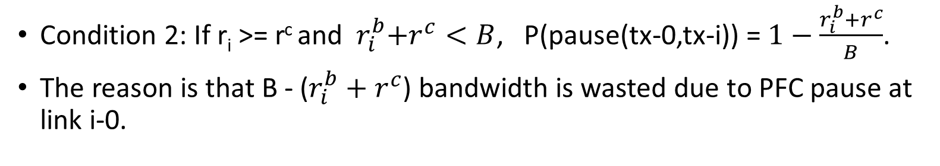
Probability of Pause Event
r₁
1
tx-1
flow 1
r₁⁰
rx-1
0
…
r_{i}
r₁⁰
i
r₃⁰=r^{c}
rx-i
flow i
tx-i
r₃⁰
r_{i}^{b}
tx-0
r^{c}
r₂⁰
…
rx-n
r_{n}
n
tx-n
flow n
r₂⁰
Condition 2: If r_{i} >= r^{c} and ${ r}_{i}^{b}+r^{c}<B$, P(pause(tx-0,tx-i)) = $1−\frac{r_{i}^{b}+r^{c}}{B}$.
The reason is that B - ($r_{i}^{b}+r^{c}$) bandwidth is wasted due to PFC pause at link i-0.

Slide 9
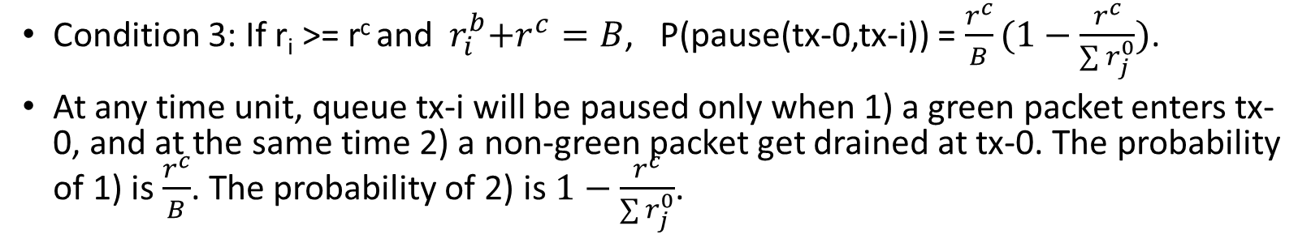
Probability of Pause Event
r₁
1
tx-1
flow 1
r₁⁰
rx-1
0
…
r_{i}
r₁⁰
i
r₃⁰=r^{c}
rx-i
flow i
tx-i
r₃⁰
r_{i}^{b}
tx-0
r^{c}
r₂⁰
…
rx-n
r_{n}
n
tx-n
flow n
r₂⁰
Condition 3: If r_{i} >= r^{c} and ${ r}_{i}^{b}+r^{c}=B$, P(pause(tx-0,tx-i)) = $\frac{r^{c}}{B}(1−\frac{r^{c}}{\sum{r_{j}^{0}}})$.
At any time unit, queue tx-i will be paused only when 1) a green packet enters tx-0, and at the same time 2) a non-green packet get drained at tx-0. The probability of 1) is $\frac{r^{c}}{B}$. The probability of 2) is$1−\frac{r^{c}}{\sum{r_{j}^{0}}}$.

Slide 10
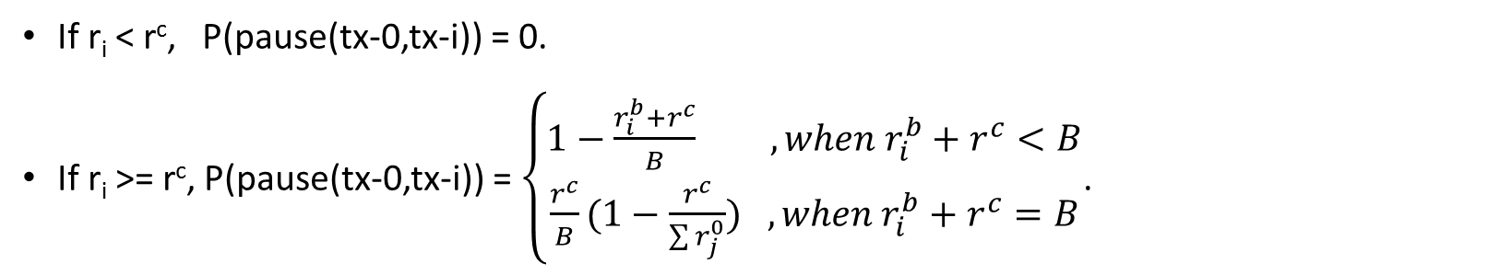
Probability of Pause Event
r₁
1
tx-1
flow 1
r₁⁰
rx-1
0
…
r_{i}
r₁⁰
i
r₃⁰
rx-i
flow i
tx-i
r₃⁰
r_{i}^{b}
tx-0
r^{c}
r₂⁰
…
rx-n
r_{n}
n
tx-n
flow n
r₂⁰
If r_{i} < r^{c}, P(pause(tx-0,tx-i)) = 0.
If r_{i} >= r^{c}, P(pause(tx-0,tx-i)) = $\left\{\begin{aligned}1−\frac{r_{i}^{b}+r^{c}}{B} ,when{ r}_{i}^{b}+r^{c}<B \\ \frac{r^{c}}{B}(1−\frac{r^{c}}{\sum{r_{j}^{0}}}) ,when{ r}_{i}^{b}+r^{c}=B\end{aligned}\right.$.

Slide 11
Impact of Extra Flows
flow 2
r₂ = B
2
K extra flows
rx
tx
K extra flows
r₁ = B
flow 1
1
3
tx
rx
flow 3
rx
tx
r₃ = B
In addition to flow 1, flow 2 and flow 3, we generate K extra flows to each link (i.e. K flows that go from switch 1 to switch 2, K flows from switch 2 to switch 3, K flows from switch 3 to switch 1.

Slide 12
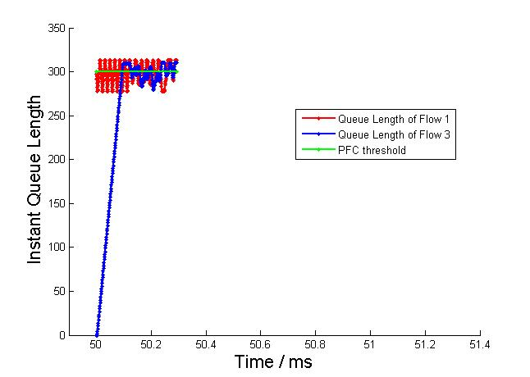
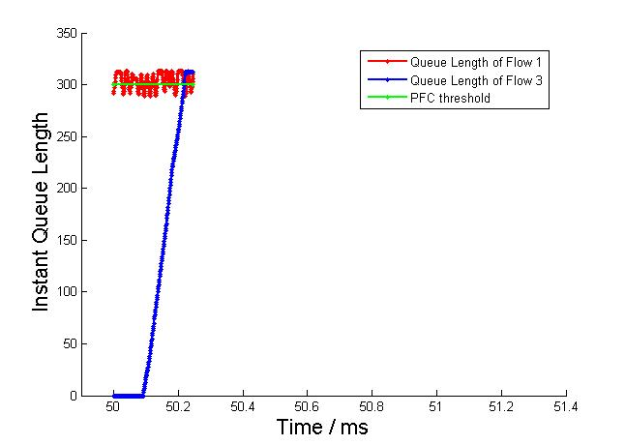
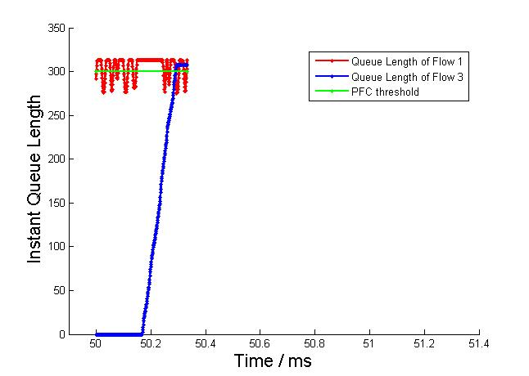
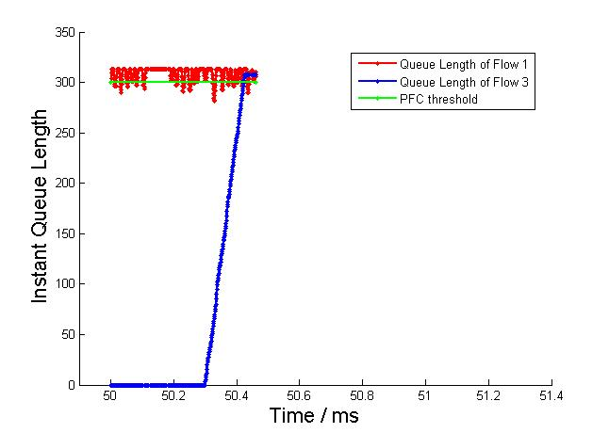
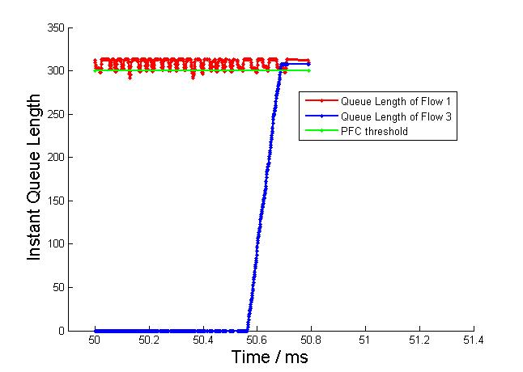
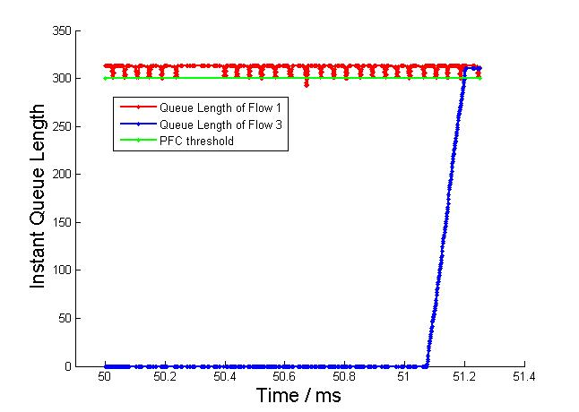
Simulation results – Exp1
Instant queue length of switch 1:
K=0
K=1
K=2
K=4
K=8
K=16

Slide 13
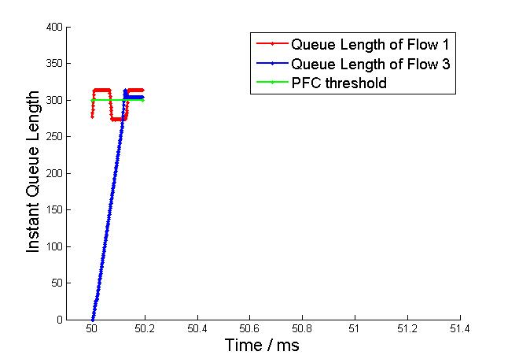
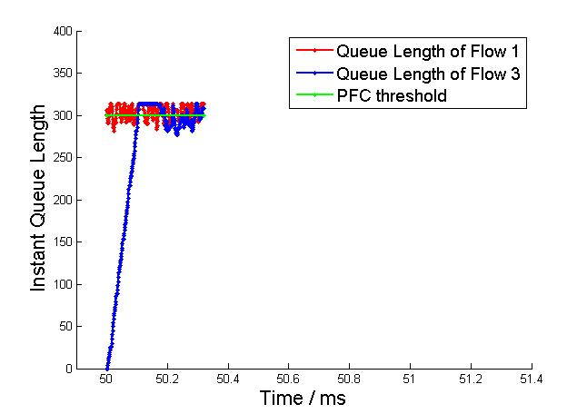
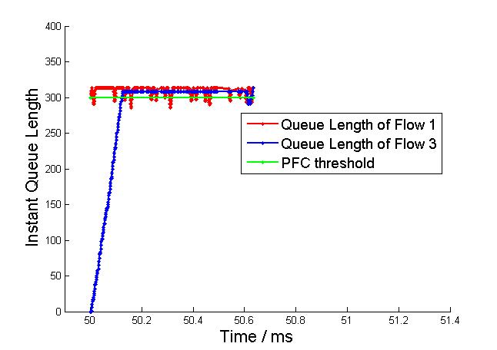
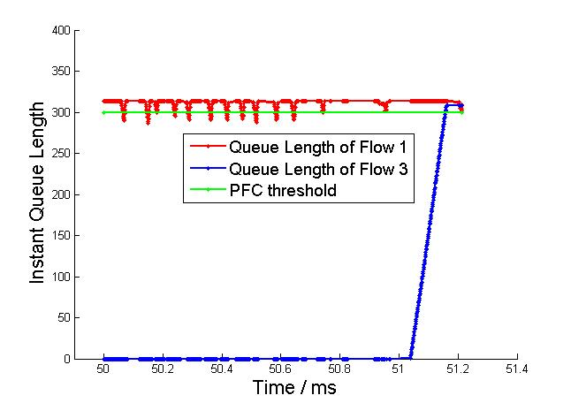
Simulation results – Exp2
Instant queue length of switch 1:
rate=1/K, K =16
rate=10/K, K=16
K=2
rate=30/K, K=16
rate=40/K, K=16

Slide 14
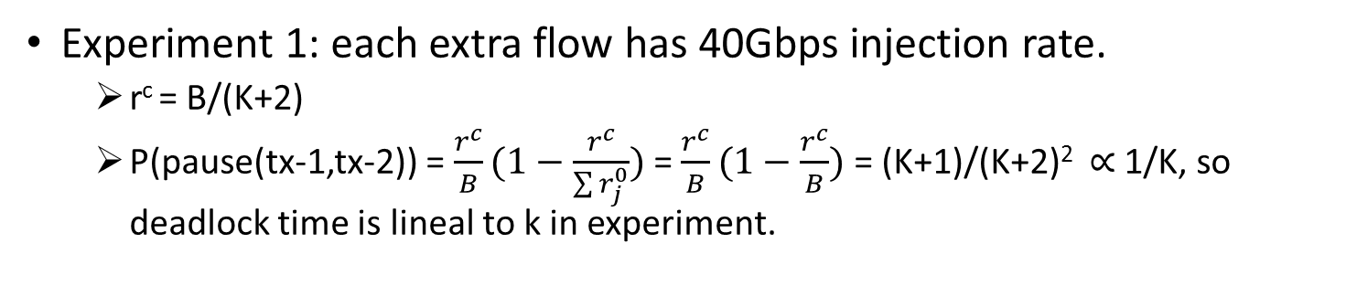
Impact of Extra Flows
Experiment 1: each extra flow has 40Gbps injection rate.
r^{c} = B/(K+2)
P(pause(tx-1,tx-2)) = $\frac{r^{c}}{B}(1−\frac{r^{c}}{\sum{r_{j}^{0}}})$ = $\frac{r^{c}}{B}(1−\frac{r^{c}}{B})$ = (K+1)/(K+2)² ∝ 1/K, so deadlock time is lineal to k in experiment.
r^{c} = B/(K+2)
flow 1
1
tx
flow 3
rx
K extra flows

Slide 15
Impact of Extra Flows
Experiment 2: each extra flow has s/K Gbps injection rate.
r^{c} = min{ (B-s)/2, B/(K+2) }
When r^{c} = (B-s)/2, P(pause(tx-1,tx-2)) = (B²-s²)/4B² is a constant, so deadlock time is constant.
When r^{c} = B/(K+2), P(pause(tx-1,tx-2)) = (K+1)/(K+2)² ∝ 1/K, so deadlock time is lineal to K.
r^{c} = min{ (B-s)/2, B/(K+2) }
flow 1
1
tx
flow 3
rx
K extra flows
s Gbps in total

Slide 16
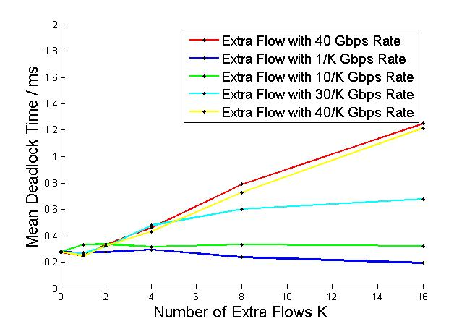
Simulation results – Exp1 & Exp 2
When the injection rate is 40Gbps or 40/K Gbps, P(pause(tx-1,tx-2)) ∝ 1/K, so deadlock time is lineal to K.
When the injection rate is 1/K Gbps or 10/K Gbps, P(pause(tx-1,tx-2)) = (B²-s²)/4B² is a constant, so deadlock time does not go up as K goes up.
When the injection rate is 30/K, P(pause(tx-1,tx-2)) ∝ 1/K at first, and then P(pause(tx-1,tx-2)) = B²-s²/4B² when k goes up, so deadlock time is lineal to K when K is small, but stay the same as K goes up.

Slide 17
Backup Slides

Slide 18
Statistical Model – Computation of P(pause(j, i, ∆t_{k}))
Case 2: Head-of-Line Blocking Pause
r₁ (> r^{c})
1
2
B
r^{c}
flow 1
rx
tx
rx
tx
rx-2
pause
r₂
?
pause
flow 2
P( pause(2, 1, ∆t_{k})=1 ) = 1-(r₂+r^{c})/B >0
3
tx
4
r₂
tx
rx
Condition 1: r₂ < r^{c} → P( pause(1, 4, ∆t_{k})=1 ) = 0

Slide 19
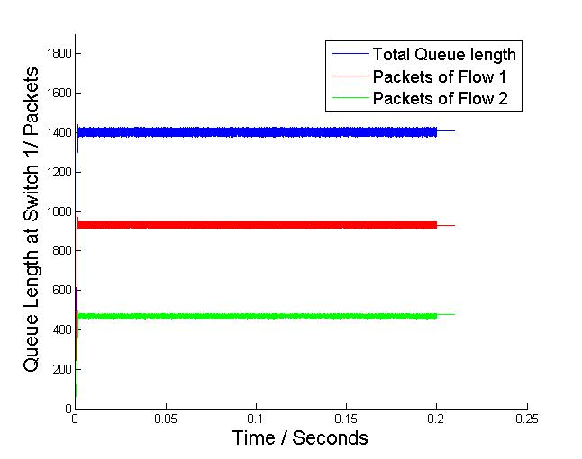
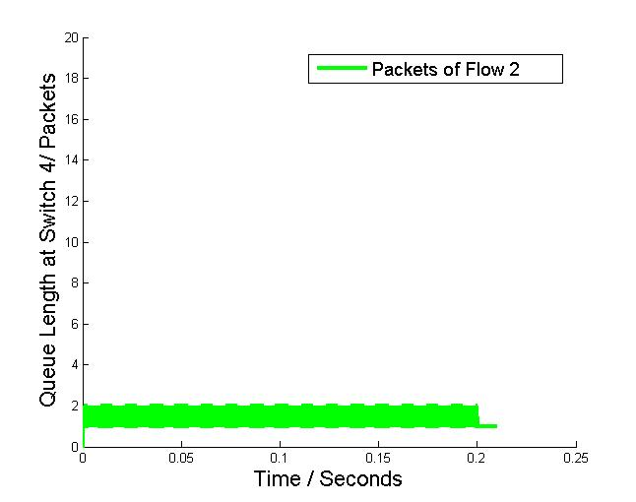
Statistical Model – Computation of P(pause(j, i, ∆t_{k}))
Simulation Results when setting r^{c} = B/2=20Gbps, r₂ =B/4=10Gbps:
1
1/2
Instant queue length of tx queue of switch 1
Instant queue length of tx queue of switch 4
At switch 1, queue length of flow 2 is half of flow 1’s, which complies with their drain rates at switch 1.
Almost no packets are queued at switch 4.

Slide 20
Statistical Model – Computation of P(pause(j, i, ∆t_{k}))
Case 2: Head-of-Line Blocking Pause
r₁ (> r^{c})
1
2
B
r^{c}
flow 1
rx
tx
rx
tx
rx-2
pause
r^{c}
?
pause
flow 2
P( pause(2, 1, ∆t_{k})=1 ) = 1-2r^{c}/B >= 0
When r^{c}=B/2, P( pause(2, 1, ∆t_{k})=1 ) =0
3
tx
4
r₂
tx
rx
Condition 2: r₂ = r^{c} → P( pause(1, 4, ∆t_{k})=1 ) = 1-r^{c}/B

Slide 21
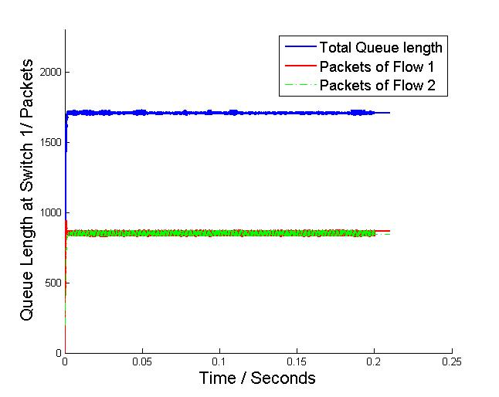
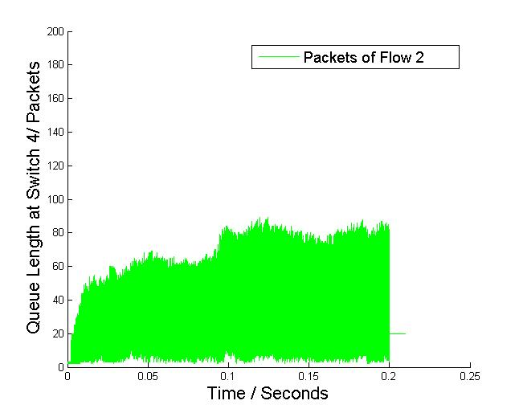
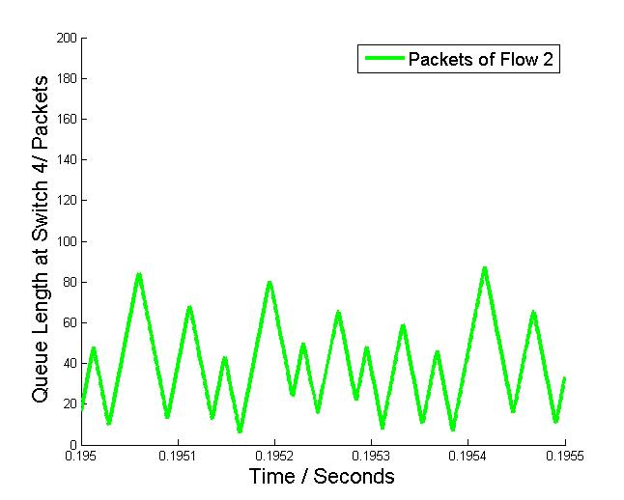
Statistical Model – Computation of P(pause(j, i, ∆t_{k}))
Simulation Results when setting r^{c} = B/2=20Gbps, r₂ =B/2=20Gbps:
Instant queue length of tx queue of switch 1
Instant queue length of tx queue of switch 4
At switch 1, queue length of flow 2 is the same as flow 1’s, which complies with their drain rates at switch 1.
Some packets are queued at switch 4. Switch 4 is paused by switch 1 intermittently.

Slide 22
Statistical Model – Computation of P(pause(j, i, ∆t_{k}))
Case 2: Head-of-Line Blocking Pause
r₁ (> r^{c})
1
2
B
r^{c}
flow 1
rx
tx
rx
tx
rx-2
r₂=0
?
pause
flow 2
3
tx
4
r₂
tx
rx
At the very beginning, It will take some time for green packets to gradually achieve rate r^{c} at switch 1. During this period, we have r₂ < r^{c} and a small part of green packets get queued at switch 4.
This part of packets will never be drained under the condition when r₂ = r^{c} at the sender, and it will cause P( pause(1, 4, ∆t_{k})=1 ) = 1-r^{c}/B.

Slide 23
Statistical Model – Computation of P(pause(j, i, ∆t_{k}))
Case 2: Head-of-Line Blocking Pause
r₁ (> r^{c})
1
2
B
r^{c}
flow 1
rx
tx
rx
tx
rx-2
pause
r^{c}
?
pause
P( pause(2, 1, ∆t_{k})=1 )=1-r^{c}/B
flow 2
3
tx
4
r₂
tx
rx
Condition 3: r₂ > r^{c} → P( pause(1, 4, ∆t_{k})=1 ) = 1-r^{c}/B

Slide 24
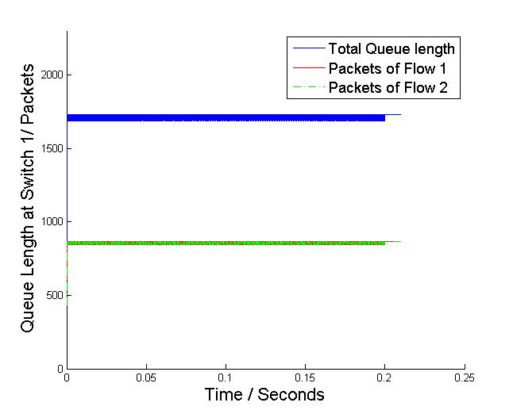
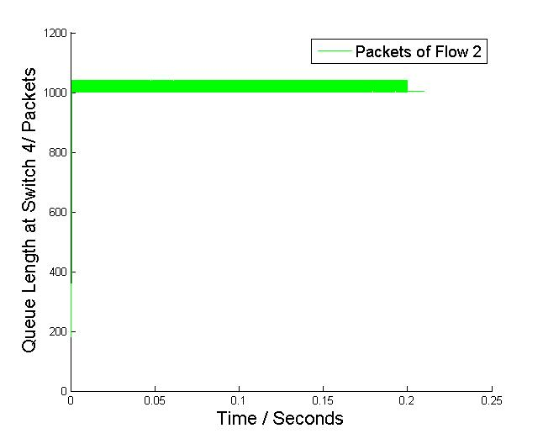
Statistical Model – Computation of P(pause(j, i, ∆t_{k}))
Simulation Results when setting r^{c} = B/2=20Gbps, r₂ =B=40Gbps:
Instant queue length of tx queue of switch 1
Instant queue length of tx queue of switch 4
At switch 1, queue length of flow 2 is the same as flow 1’s, which complies with their drain rates at switch 1.
Packets are queued at switch 4 and exceed PFC threshold. Switch 4 is paused by switch 1 intermittently.

